Slide 1







Team: Hack14
Members: Kenk, Mabel, Ashton, Nuode, Reily
Safeguarding the future of philanthropy
Workspace Name: Team14-Giv3
GitHub Link: https://github.com/Hackhaton-2022/giv3-core
https://github.com/Hackhaton-2022/giv3-interface

Slide 2

Overview
Problem statement
Problem
Title
How NFTs could be used for building philanthropic communities
First Round
Lack of transparency in the traditional infrastructure; too much inefficiency & fraud
Difficult to remain anonymous when donating; censorship resistance
Little social recognition, emotional feedback and a sense of belonging
Key Issue
Our solution
An all-in-one web platform to empower impact makers by:
Offering a decentralised platform which increases transparency
Allowing donors to make anonymous donations through a decentralized autonomous organization (DAO)
Rewarding donors and volunteers with a dynamic non-fungible token (NFT)
Key
Takeaway
With better a platform and improved incentives for donors, we expect to see a rise in number of donations to philanthropic organisations
Overview of problem statement
Problem
Our solution and product
Business model
Market analysis
Fundraising needs and the team

Slide 3
Problem
Censorship and anonymity issues prevent individuals from making donations to philanthropic organizations
Insight 1
Only half of U.S. households donated to charity, worst rate in decades.
Individuals would be encouraged to donate if there is a trust system in place to efficiently track their donations.
Insight 2
According to a study done by the Indiana University Lilly Family School of Philanthropy, declining levels of trust among Americans for institutions and each other contributed to the move away from charitable giving.
Insight 3
African Americans and Hispanics/Latinos also became less likely to say assessing charity trust is “easy”, going from 24.4% to 15.1% and
from 25.6% to 9.9%, respectively.
Giv3 provides an infrastructure which promotes transparency through a decentralized system, fostering the trust of donors and therefore resulting in higher donations.
Overview of problem statement
Problem
Our solution and product
Business model
Market analysis
Fundraising needs and the team
Notes:
A study done by CBS news
https://www.cbsnews.com/news/charity-donations-us-households-decline/
https://www.give.org/docs/default-source/donor-trust-library/2020-donor-trust-report.pdf

Slide 4
Problem
Fewer people are donating due to a lack of transparency and trust in philanthropic organizations
Insight 1
Individuals would be encouraged to donate if there is a trust system in place to efficiently track their donations.
In a dataset of more than $44 million in online donations, it was observed that 21% were made while opting to be anonymous to the public.
Insight 2
Donors might not want to be associated with controversial organizations they support or causes that are not widely endorsed by their community.
Giv3 allows individuals to donate anonymously through a decentralized autonomous organization, resulting in more donations.
Overview of problem statement
Problem
Our solution and product
Business model
Market analysis
Fundraising needs and the team
Notes:
https://www.nature.com/articles/s41467-019-11852-z#:~:text=In%20a%20dataset%20of%20more,attributable%20to%20any%20egoistic%20goal.
https://www.aefonline.org/blog/why-clients-decide-donate-publicly-or-anonymously

Slide 5
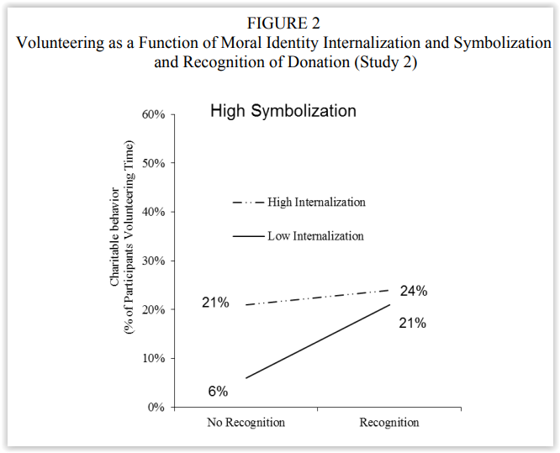
Problem
The lack of social recognition and a sense of belonging discourage donors from making donations
Insight 1
According to a research paper titled “Selective Recognition:
How to Recognize Donors to Increase Charitable Giving”, it was observed that all forms of recognition have a positive impact on increasing donations,
with selective recognition having the most significant effect.
Insight 2
In another study titled “When Does Recognition Increase Charitable Behavior?”, individuals are 3-15% more likely to volunteer their time when they receive recognition. s might not want to be associated with controversial organizations they support or causes that are not widely endorsed by their community.
Giv3 rewards donors with a dynamic NFT when they join our platform and additional accessories when they make donations, which they can upload and display on their social media accounts.
Overview of problem statement
Problem
Our solution and product
Business model
Market analysis
Fundraising needs and the team
Notes:
https://www.researchgate.net/publication/256062061_When_Does_Recognition_Increase_Charitable_Behavior_Toward_a_Moral_Identity-Based_Model
https://www.chapman.edu/research/institutes-and-centers/economic-science-institute/_files/WorkingPapers/Red-Cross-2015.pdf

Slide 6
Product Demo
Overview of problem statement
Problem
Our solution and product
Business model
Market analysis
Fundraising needs and the team

Slide 7
Business model
Product Customer Journey
Individual creates a Giv3 profile and received a dynamic NFT avatar
Promotes the supported philanthropic community
Donor joins a DAO and interacts with its community
Individual showcases avatar on social media
Donation/ impact is completed, donor receives enhanced accessories to upgrade avatar
Overview of problem statement
Problem
Our solution and product
Business model
Market analysis
Fundraising needs and the team

Slide 8


Business model
Revenue Streams
Commission + forex rate
Selling of advertising spaces on Giv3’s platform
Giv3 will charge 1% of the donation amount as commission. Any positive slippage relating to forex rates will be accounted as revenue as well.
6.6 million * $1400 * 1% = $92.4 million in annual commission fee.
We project to make $4 in ad revenue per user per year.
$4 * 6.6 million = $26 million in annual ad revenue.
Here we used conservative data on average donation. Average American donation in 2020 = $1400
More than 50% of Americans made donations last year. 4% of US donors = 6.6 million users
*All figures are in USD
Overview of problem statement
Problem
Our solution and product
Business model
Market analysis
Fundraising needs and the team
Notes:
https://fortune.com/2021/06/15/americans-gave-a-record-471-billion-to-charity-in-2020-pandemic/
https://nonprofitssource.com/online-giving-statistics/#:~:text=By%20the%20end%20of%20last,donated%20money%20to%20nonprofit%20organizations.

Slide 9

Market analysis
Market Sizing (estimate)
USD $11.48 billion
Serviceable Obtainable Market
Assuming we can capture 4% of the market
$287 billion * 4% = $11.48 billion
USD $287 billion
Serviceable Available Market
70% of donations are made by individuals
70% * $410 billion = $287 billion
USD $410 billion
Total Addressable Market
Total giving is anticipated to rise 4.1 percent in 2021 and 5.7 percent in 2022
*All figures are in USD
Overview of problem statement
Problem
Our solution and product
Business model
Market analysis
Fundraising needs and the team
Notes:
https://www.charitynavigator.org/index.cfm?bay=content.view&cpid=42
https://blog.philanthropy.iupui.edu/2021/02/19/the-outlook-for-charitable-giving/

Slide 10








Market analysis
Competitor analysis
Market
Global
United States
United States
Payment
Crypto + Fiat
Crypto
Crypto + fiat
Percentage Fee
1% for Crypto and fiat
5% for crypto
1% for crypto
2%-3% for fiat
All-around community
Nil
Nil
Community Interaction
Profile Building
Avatar profile can be upgraded over time
Nil
Nil
Overview of problem statement
Problem
Our solution and product
Business model
Market analysis
Fundraising needs and the team
Notes:
https://thegivingblock.com/
https://www.every.org/

Slide 11
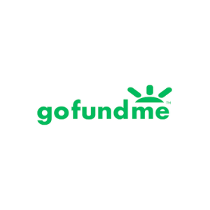
Market analysis
Competitor Valuation
Shift4 Buys Crypto Donation Firm The Giving Block for Up to $300M- CoinDesk
GoFundMe’s Valuation Rises To Around $600M-$650M In Latest Funding Round
Company valued at $300 million
Company valued at $600-$650 million
*All figures are in USD
Overview of problem statement
Problem
Our solution and product
Business model
Market analysis
Fundraising needs and the team
Notes:
https://www.coindesk.com/business/2022/03/01/crypto-donation-firm-the-giving-block-bought-by-payment-services-provider-shift4/
https://techcrunch.com/2015/06/22/gofundmes-valuation-rises-to-nearly-600m-650m-in-latest-funding-round/

Slide 12
Product
Fundraising needs
Item
Pre-money valuation | $10M
Runway | 12 months
Funding amount | $700K
Expected revenue during the period | $30K
Tech spending | -$300K
Market spending | -$100K
Other spending | -$200K
*All figures are in USD
Overview of problem statement
Problem
Our solution and product
Business model
Market analysis
Fundraising needs and the team
Notes:
A pre-money valuation is a term widely used in the private equity and venture capital industries. It refers to the valuation of a company or asset prior to an investment or financing.

Slide 13


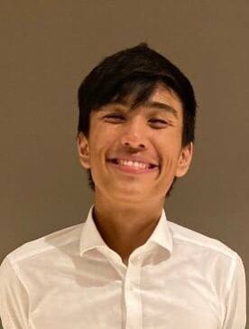
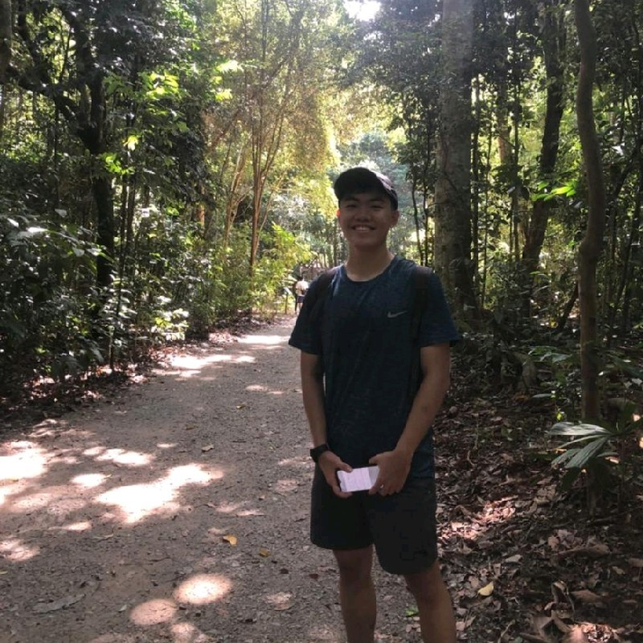
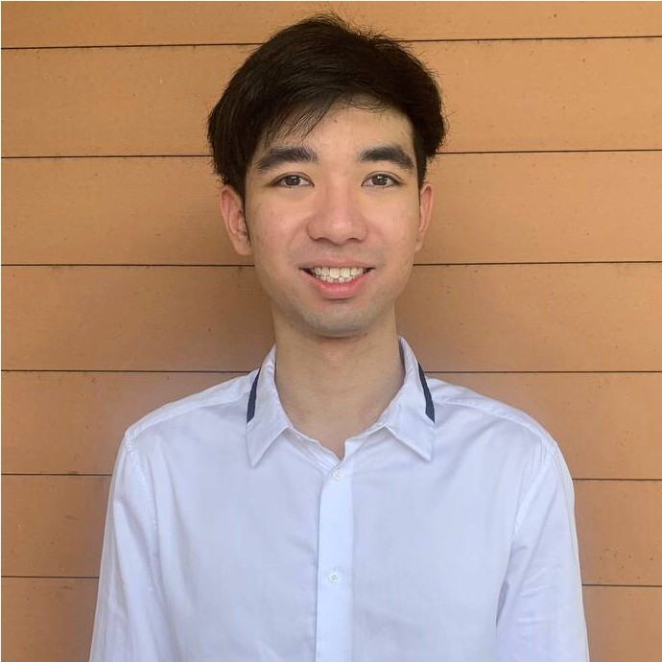
Behind the scenes
Our team
Kenk
Full-stack Developer
Mabel Khaw
UIUX designer
Ashton Goh
Full-stack Developer
Nuode Chen
Full-stack Developer
Reily Lim
Business developer
Overview of problem statement
Problem
Our solution and product
Business model
Market analysis
Fundraising needs and the team

Slide 14
Appendix
https://www.cbsnews.com/news/charity-donations-us-households-decline/
https://www.give.org/docs/default-source/donor-trust-library/2020-donor-trust-report.pdf
https://www.nature.com/articles/s41467-019-11852-z#:~:text=In%20a%20dataset%20of%20more,attributable%20to%20any%20egoistic%20goal.
https://www.aefonline.org/blog/why-clients-decide-donate-publicly-or-anonymously
https://www.researchgate.net/publication/256062061_When_Does_Recognition_Increase_Charitable_Behavior_Toward_a_Moral_Identity-Based_Model
https://www.chapman.edu/research/institutes-and-centers/economic-science-institute/_files/WorkingPapers/Red-Cross-2015.pdf
https://fortune.com/2021/06/15/americans-gave-a-record-471-billion-to-charity-in-2020-pandemic/
https://nonprofitssource.com/online-giving-statistics/#:~:text=By%20the%20end%20of%20last,donated%20money%20to%20nonprofit%20organizations.
https://www.charitynavigator.org/index.cfm?bay=content.view&cpid=42
https://blog.philanthropy.iupui.edu/2021/02/19/the-outlook-for-charitable-giving/
https://thegivingblock.com/
https://www.every.org/
https://www.coindesk.com/business/2022/03/01/crypto-donation-firm-the-giving-block-bought-by-payment-services-provider-shift4/
https://techcrunch.com/2015/06/22/gofundmes-valuation-rises-to-nearly-600m-650m-in-latest-funding-round/

Slide 15


Problem
Fewer people are donating due to a lack of transparency and trust in philanthropic organizations
Only half of U.S. households donated to charity, worst rate in decades.
According to a study done by the Indiana University's Lilly Family School of Philanthropy, declining levels of trust among Americans for institutions and each other contributed to the move away from charitable giving.
Individuals would be encouraged to donate if there is a trust system in place to efficiently track their donations.
African
Americans and Hispanics/Latinos also
became less likely to say assessing charity
trust is “easy”, going from 24.4% to 15.1% and
from 25.6% to 9.9%, respectively.
Giv3 provides an infrastructure which promotes transparency through a decentralized system, fostering the trust of donors and therefore resulting in higher donations.
Overview of problem statement
Problem
Our solution and product
Business model
Market analysis
Fundraising needs and the team
Notes:
A study done by CBS news
https://www.cbsnews.com/news/charity-donations-us-households-decline/
https://www.give.org/docs/default-source/donor-trust-library/2020-donor-trust-report.pdf

Slide 16


Problem
Censorship and anonymity issues prevent individuals from making donations to philanthropic organizations
In a dataset of more than $44 million in online donations, it was observed that 21% were made while opting to be anonymous to the public.
When individuals know that their identity will remain anonymous while donating to philanthropic communities, they would be more encouraged to make donations.
Donors might not want to be associated with controversial organizations they support or causes that are not widely endorsed by their community.
Giv3 allows individuals to donate anonymously through a decentralized autonomous organization, resulting in more donations.
Overview of problem statement
Problem
Our solution and product
Business model
Market analysis
Fundraising needs and the team
Notes:
https://www.nature.com/articles/s41467-019-11852-z#:~:text=In%20a%20dataset%20of%20more,attributable%20to%20any%20egoistic%20goal.
https://www.aefonline.org/blog/why-clients-decide-donate-publicly-or-anonymously

Slide 17


Problem
The lack of social recognition and a sense of belonging discourage donors from making donations
According to a research paper titled “Selective Recognition:
How to Recognize Donors to Increase Charitable Giving”, it was observed that all forms of recognition have a positive impact on increasing donations,
with selective recognition having the most significant effect.
In another study titled “When Does Recognition Increase Charitable Behavior?”, individuals are 3-15% more likely to volunteer their time when they receive recognition.
Giv3 rewards donors with a dynamic NFT when they join our platform and additional accessories when they make donations, which they can upload and display on their social media accounts.
Overview of problem statement
Problem
Our solution and product
Business model
Market analysis
Fundraising needs and the team
Notes:
https://www.researchgate.net/publication/256062061_When_Does_Recognition_Increase_Charitable_Behavior_Toward_a_Moral_Identity-Based_Model
https://www.chapman.edu/research/institutes-and-centers/economic-science-institute/_files/WorkingPapers/Red-Cross-2015.pdf

Slide 18



Market analysis
Competitor analysis
Global
United States
Yes. For healthcare teams, manages Patient healthcare team’s administrative tasks in one place
Market
Crypto + Fiat
Crypto
Limited. Mostly functions as a collaborative “to-do” list for healthcare teams
Payment
Community Interaction
All-around community
5% for Crypto
Limited. Separate solution,does not integrate with request approval workflows for local healthcare systems
Profile Building
Avatar profile can be upgraded over time
Nil
Gap #3: Quick request approval
for daily operations
Nil
Nil
Limited. Does not connect to other key medical stakeholders beyond teams
Receive, send and forward requests easily with a few taps
MEDCO
Overview of problem statement
Problem
Our solution and product
Business model
Market analysis
Fundraising needs and the team
Notes:
https://thegivingblock.com/
https://www.every.org/

Slide 19


01 PROBLEM
Problem Statement
JTBD
Competitor Analysis
MEDCO
Notes:
Let us first begin with our initial problem context

Slide 20
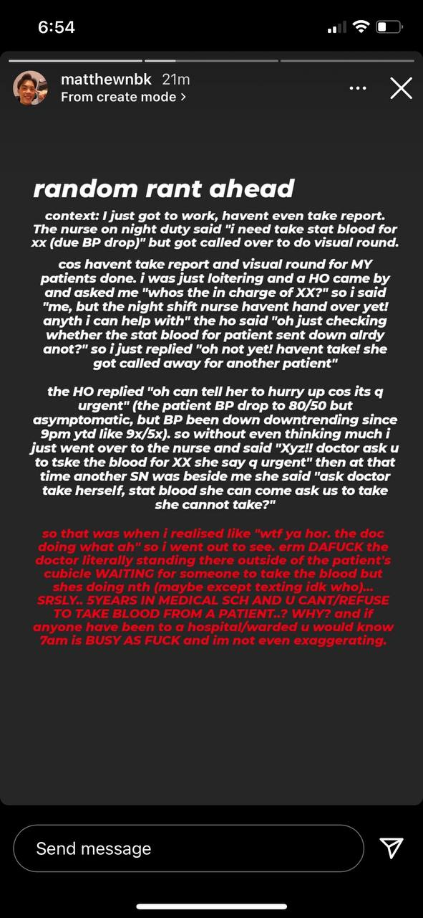
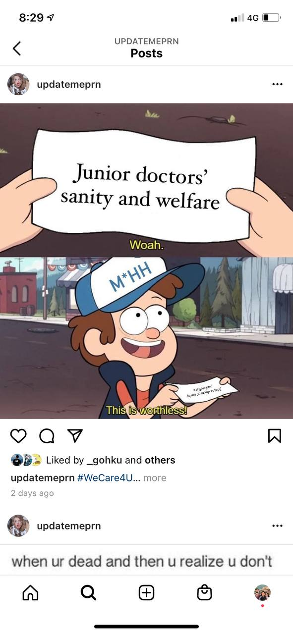
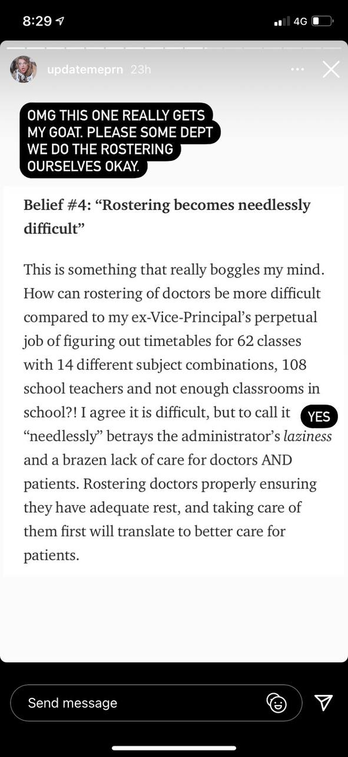
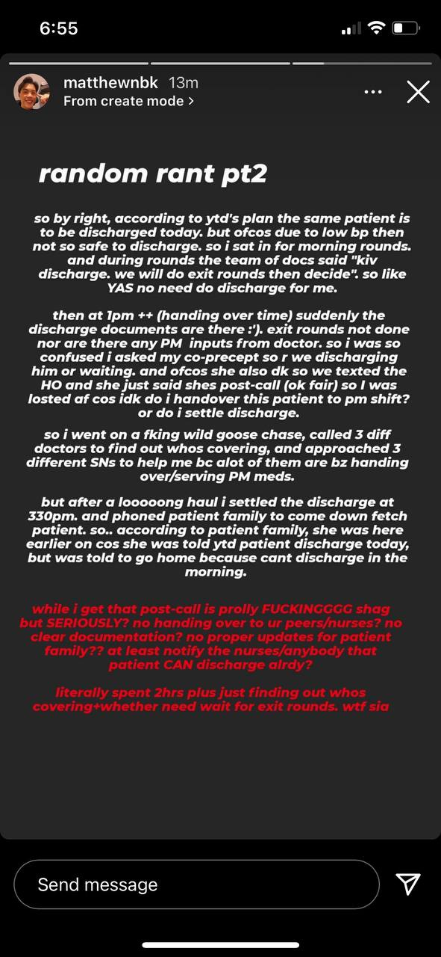
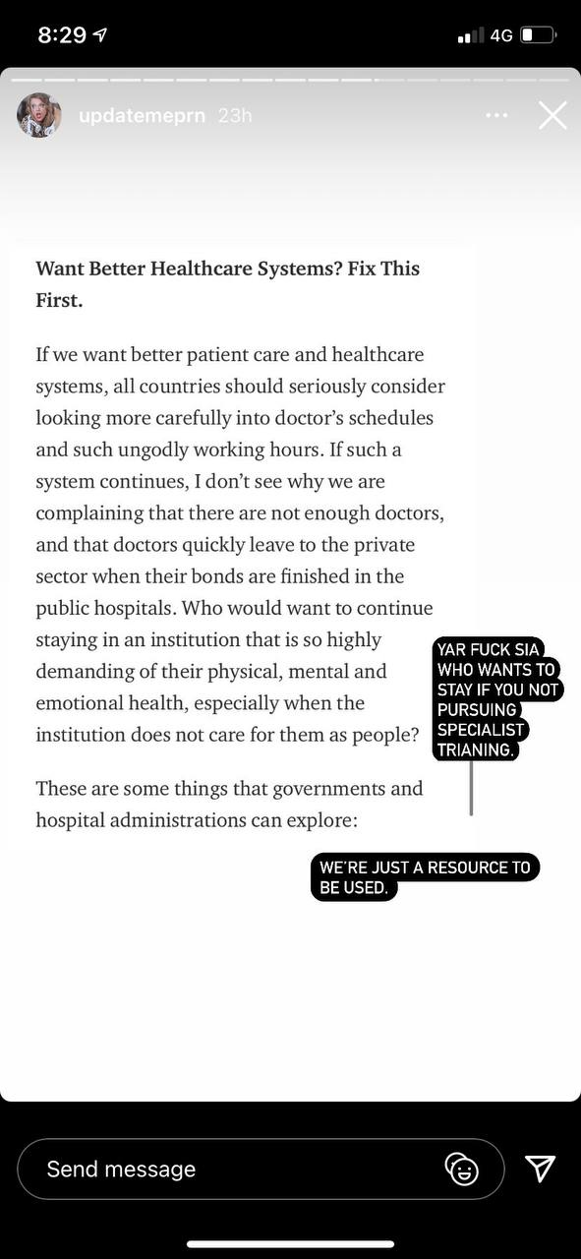
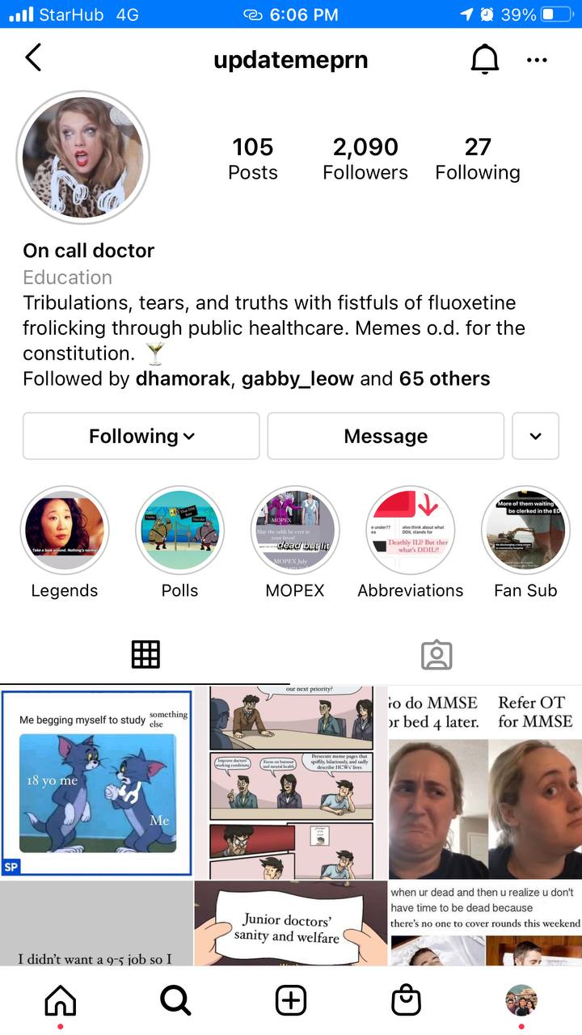
THE PROBLEM
Doctors and medical staff are overworked & exhausted
MEDCO
Notes:
Doctors and medical staff are being overwork due to the inefficiencies in the workplace.
Doctors bombarded Administrative work - info transfer, multiple documentation , job rostering and miscommunication issues
RELATABBILITY FACTORtakes up a large amount of time during their work schedule and often overflows to outside work hours as well cause doctors to be severely overworked. Such an issue is relatable ia, and even in doctor-meme accounts, memes are often centreed arnd lack of doctor’s sanity and welfare

Slide 21


VALUE PROPOSITION
PROBLEM: INEFFICIENT COLLABORATION WITHIN INTERNAL MEDICAL TEAMS
HEALTHCARE WORKERS
HOSPITAL ORGANISATIONS
For healthcare workers doing ward work
Who are dissatisfied with the current methods of collaboration within the department,
Our product is a collaboration app for medical teams
That enables seamless patient management amongst doctors and nurses, unlike existing tools (hospital emr system, tigertext, paper and pencil) which are inconvenient and inefficient.
For Hospitals Organisations
Who want to improve system efficiency
Our product is a collaboration app for medical teams
That enables clear visibility of medical work, that can give data-driven insights on how to allocate resources and improve system efficiency. It improves patient care, and enhances the productivity and welfare of medical teams.
MEDCO
Notes:
Poor visibility of tasks & mundane administrative task management within medical teams (including doctors, and nurses) results in wasted hours
Macro-level overview, understand day to day tasks on the ground

Slide 22


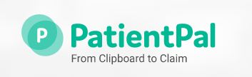



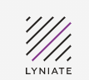
COMPETITIVE POSITIONING
Ease of internal team
collaboration amongst stakeholders
Our solution
Patient - centric
Healthcare worker - centric solution
Rhapsody
External stakeholder facing
MEDCO
Notes:
Collaborative task workflow solution amongst stakeholders (full visibility and collaboration)

Slide 23
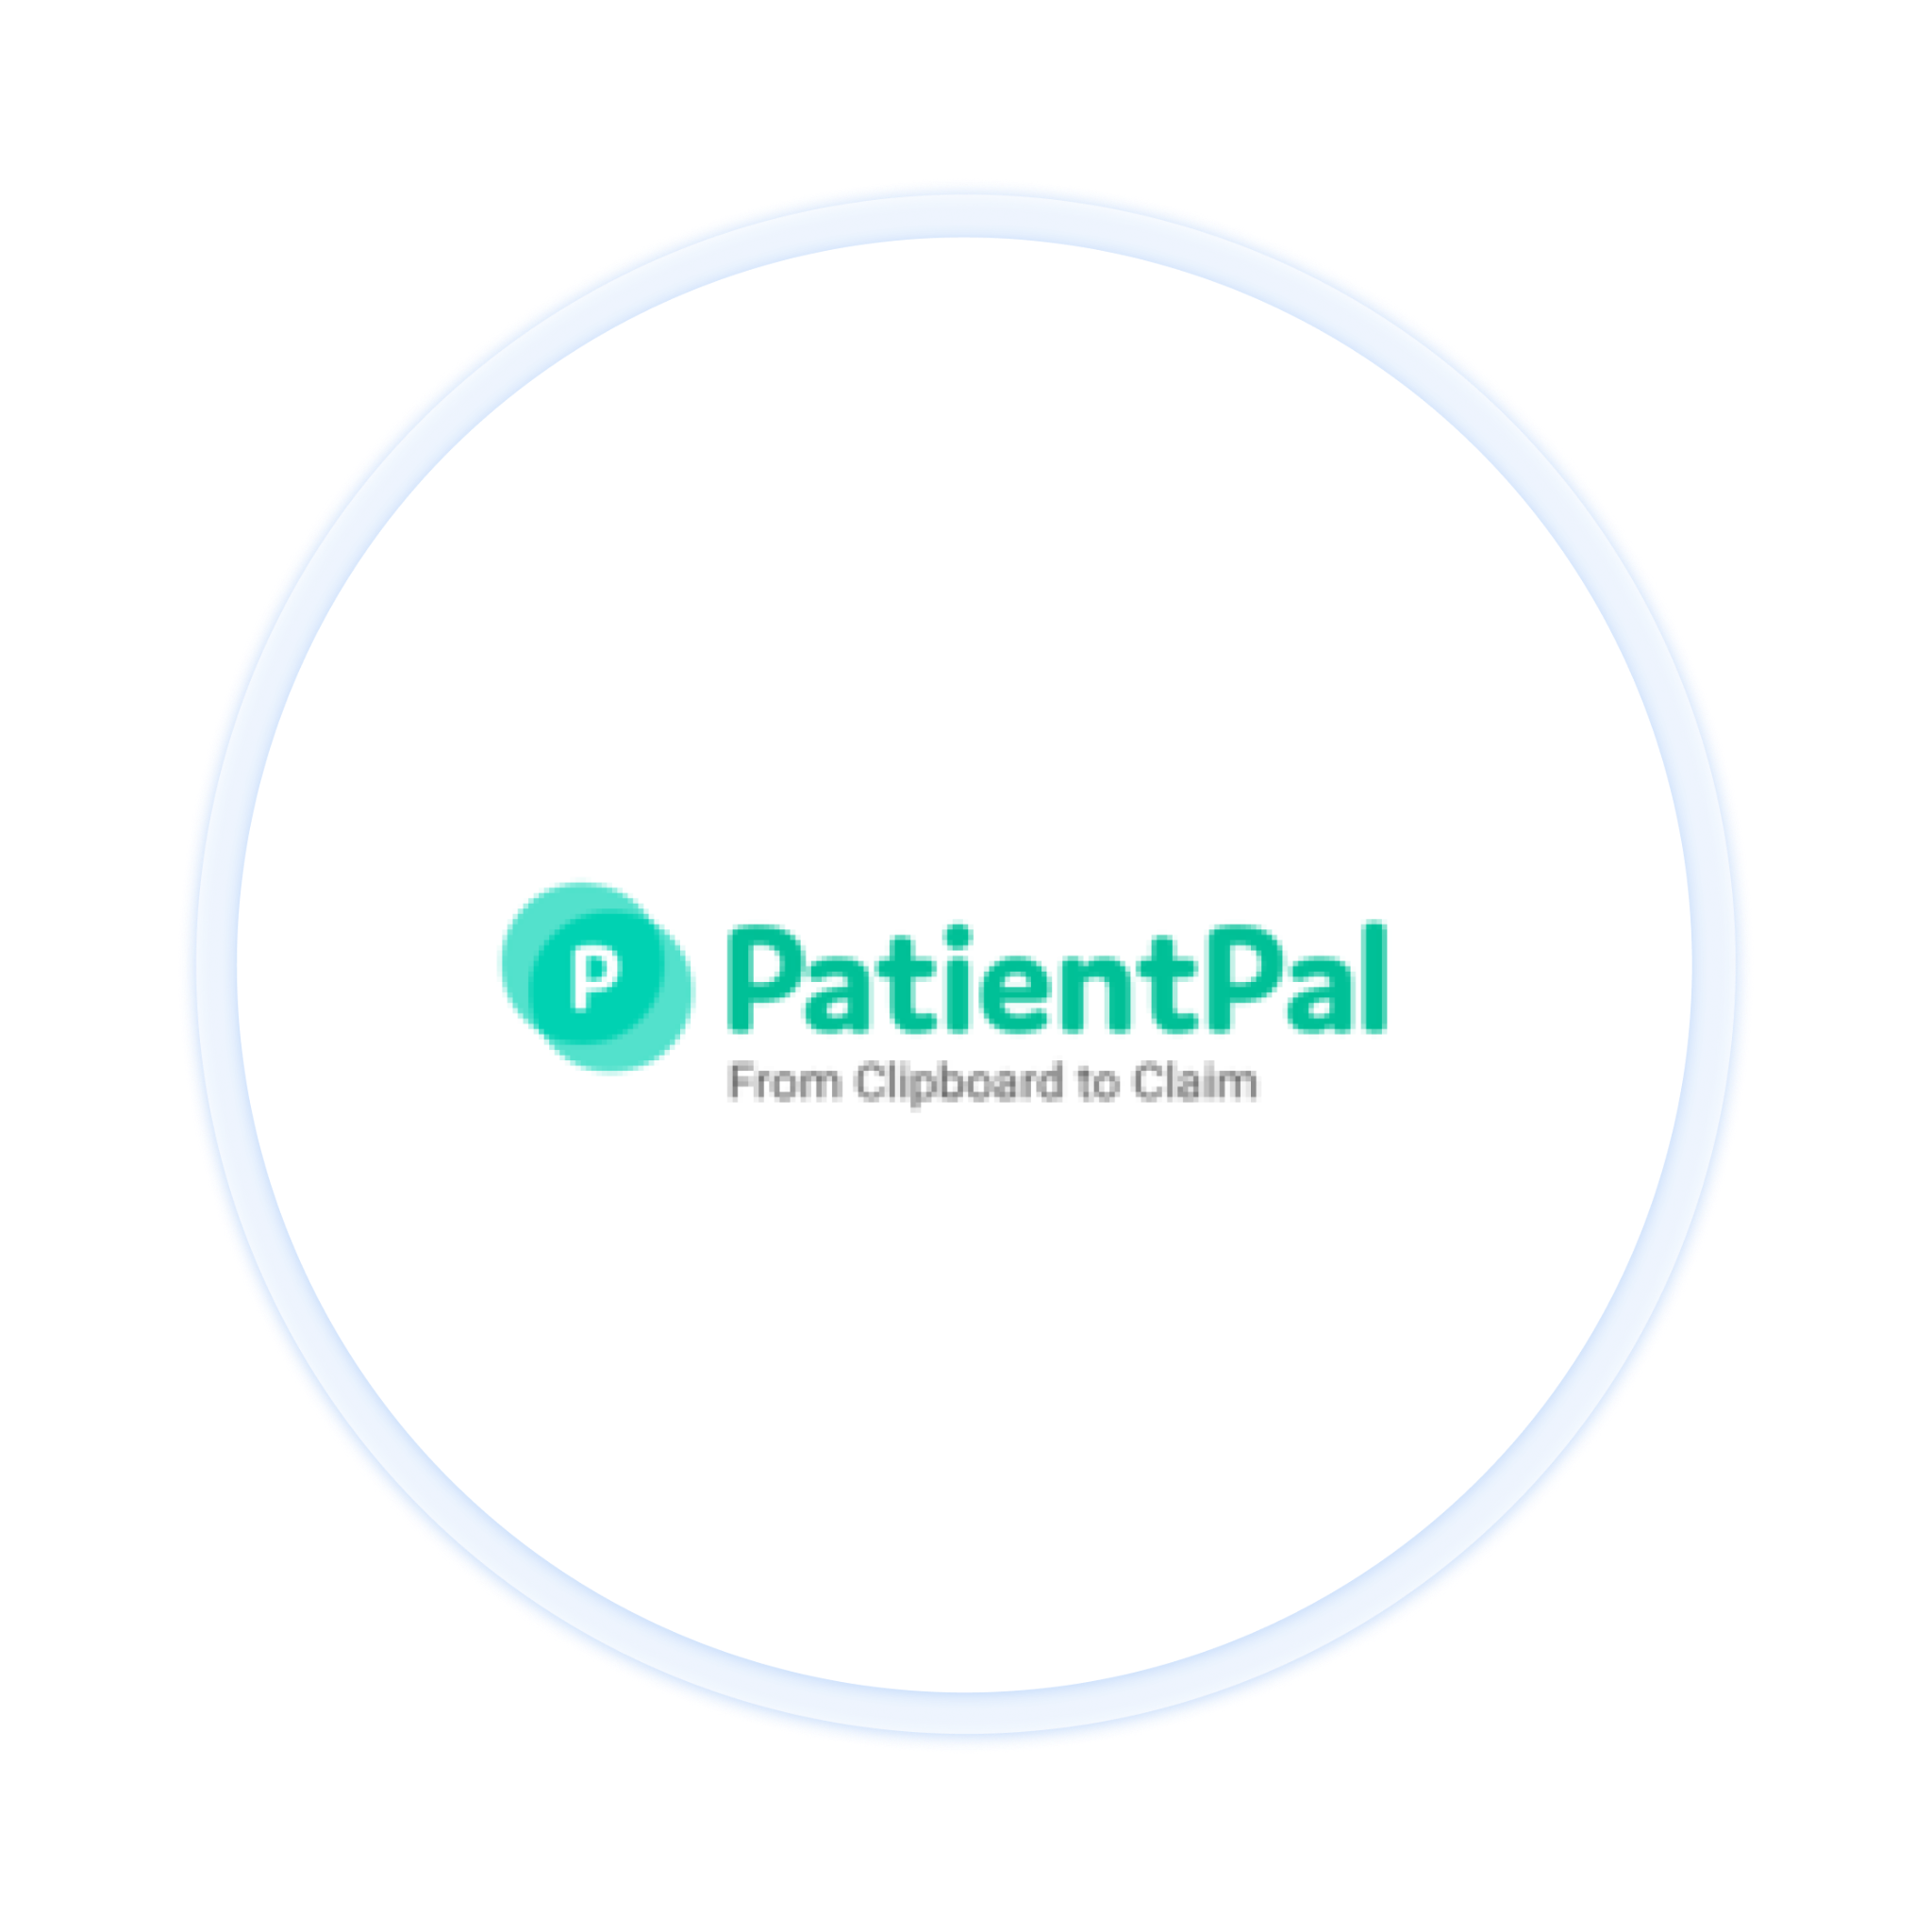


ANALYSIS OF COMPETING SOLUTIONS
A platform that automates filling of manual entry tasks
A communication platform that connects the entire healthcare ecosystem
A task management platform to manage administrative and clinical tasks.
Mostly focused on front-desk and patient communication
Offers a wide range of functions and features, more patient-communication facing
Functions mostly as a collaborative ”to-do”list
Does not cater to Doctors
Not designed for collaboration
Not sufficient for the way
that healthcare teams
work locally
MEDCO
Notes:
Root cause- internal system inefficiences

Slide 24

JTBD COMPETITIVE DIFFERENTIATION - FEATURES
No. Mainly focused on eliminating front-desk bottleneck between Patient and front-desk staff
Yes. Platform that connects internal and external teams, patients, systems, and insights
Yes. For healthcare teams, manages Patient healthcare team’s administrative tasks in one place
Yes. Internal stakeholders are able to communicate easily and stay updated on key patient updates
JTBD #1: Improve communication within healthcare stakeholders
JTBD #2 : Internal collaboration and integration of workflows within medical teams
Limited. Offers a wide range of functions, but does not specifically address internal collaboration
Limited. Mostly functions as a collaborative “to-do” list for healthcare teams
Yes. Create, view and manage personal tasks across teams and staff departments that integrates with existing workflows
No. Automate filling of manual entry tasks
JTBD #3: Quick patient request approval across stakeholders
No. Does not manage patient requests and approvals within Doctors and Nurses
Limited. Manual requesting through text-app
Limited. Separate solution,does not integrate with request approval workflows for local healthcare systems
Yes, facilitates request approval between doctors, nurses and house officers
JTBD #4 (Enterprise): Get visibility and data on the healthcare workers' day to day tasks
Yes. Macro and micro level data analysis of day-to-day tasks and overall enterprise system
Nil
Limited. No visibility of day-to-day tasks
Nil
MEDCO
Notes:
While most are … communication
Limited : Internal collaboration (specific, strictly targeting internal)
Cross-collaboration
(medco is the ONLY solution that ENABLES hospital management to understand what’s going on on the ground fpr day-to-day tasks)

Slide 25
JTBD COMPETITIVE DIFFERENTIATION - POSITIONING
Core Product
Automate filling of manual entry tasks
Communication platform that connects the entire healthcare ecosystem
task management platform to manage administrative and clinical tasks.
Internal healthcare collaboration tool for medical teams
Customer Target
Front-desk staff and patients
Patients, Healthcare Providers (internal and external)
Hospital staff teams
Mainly Doctors and House Officers + Nurses
Gap #1: Enable macro visibility of internal day-to-day tasks
No. Does not cater to Doctors
Not exactly, generalised for all stakeholders
Yes, within medical teams.
Yes. Specialised healthcare worker & hospital management centric solution
No.Only addresses front-desk visibility
No. More patient-comms facing instead of internal patient management
Largely “microscale within teams,” does not facilitate macro collaboration across stakeholders
View team tasks, with seamless integration with personal workflows
Gap #2: Ease of collaboration in patient management
Gap #3: Quick request approval
for daily operations
Nil
Nil
Limited. Does not connect to other key medical stakeholders beyond teams
Receive, send and forward requests easily with a few taps
MEDCO
Notes:
nternal healthcare management (macro + micro), healthcare workers centric + hospital managemeent

Slide 26

02 VALIDATION
Analysis of Competitors
Assumption Validation
Interview strategy
Target market
MEDCO
Notes:
shows our validation procxess

Slide 27






ASSUMPTION VALIDATION
CUSTOMER IDENTIFICATION
Medical teams that have patients across wards & departments that requires collaboration
COMPETING OFFER
Competing solutions fail to address the problem effectively in Singapore
CUSTOMER PROBLEM
System is not designed for collaboration and task management
Poor visibility between different stakeholders
MEDCO is able to be integrated with hospitals’ existing EMR system. The data obtained from the healthcare workers can be used to generate useful insights for the hospital management
TECHNOLOGY
PRICE &
PERFORMANCE
Hospitals are willing to pay for MEDCO with a SaaS business model that’s charged per user & per hospital system
The use of MEDCO will result in a more efficient system which leads to better administrative management, lifting the administrative burden off healthcare workers
SOLUTION ATTRACTIVENESS
MEDCO
Notes:
for our solution to work we need we have made these few assumptions.
we are focusing our validation on the the customer identification, customer problem & solution attractiveness… because they are more important assumptions to be validated within the given time frame.

Slide 28
ASSUMPTION VALIDATION
CUSTOMER IDENTIFICATION
Medical teams that have patients across wards & departments that requires collaboration
COMPETING OFFER
Competing solutions fail to address the problem effectively in Singapore
CUSTOMER PROBLEM
System is not designed for collaboration and task management
Poor visibility between different stakeholders
MEDCO is able to be integrated with hospitals’ existing EMR system. The data obtained from the healthcare workers can be used to generate useful insights for the hospital management
TECHNOLOGY
PRICE &
PERFORMANCE
Hospitals are willing to pay for MEDCO with a SaaS business model that’s charged per user & per hospital system
A more efficient system which leads to better administrative management, lifting the administrative burden off healthcare workers
SOLUTION ATTRACTIVENESS
MEDCO

Slide 29

INTERVIEW STRATEGY
Understanding and solving the problem
1ST QUALITATIVE INTERVIEW
2ND QUALITATIVE INTERVIEW
Interview healthcare workers to understand what type of problems they face and find a problem to solve
Using the MVP and Landing page to allow our interviewees to better gauge the accuracy of our solution
QUANTITATIVE INTERVIEW
Validate solution idea and evaluate interest from healthcare workers & hospital management staff by interviewing 30 people
MEDCO
Notes:
These are our 3 iterations for how we validated the idea. First of a qualitative interview where we try to understand problems faced by the healthcare workers. Next is our quantitative interview where we get doctors validate our solution and insights that we picked out from our 1st qualitative interview
Next, our 2nd qualitative interview for a stakeholders to try out our idea with our MVP and landing page to get a better sensing of the success of our proposed solution

Slide 30
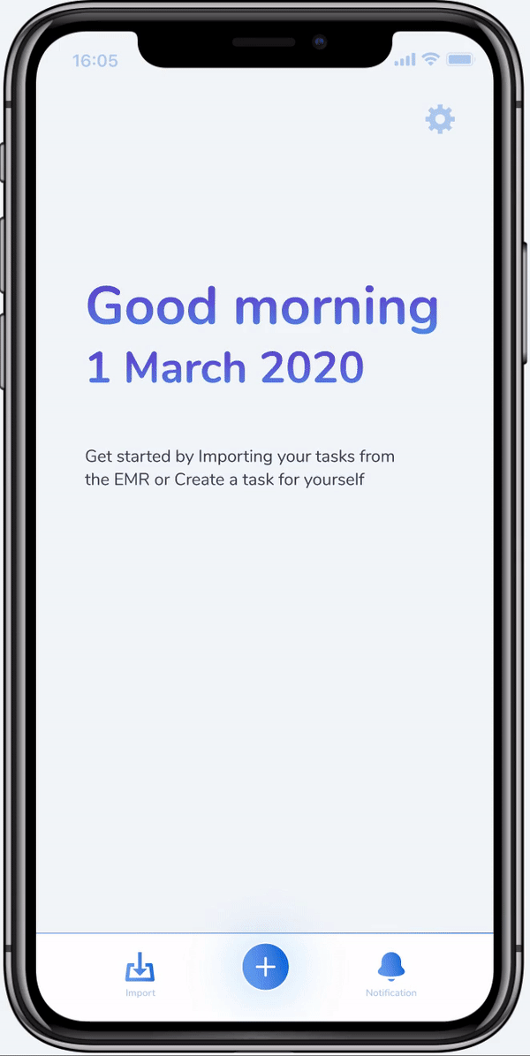
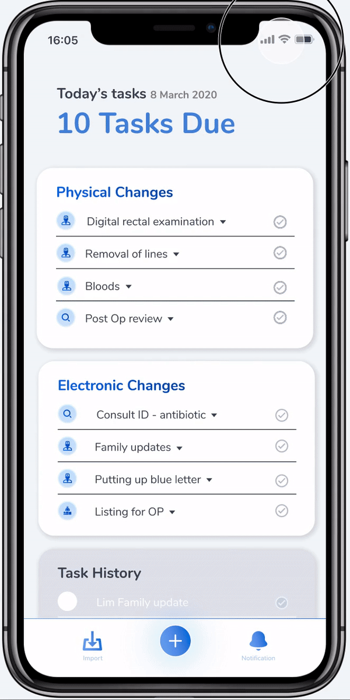
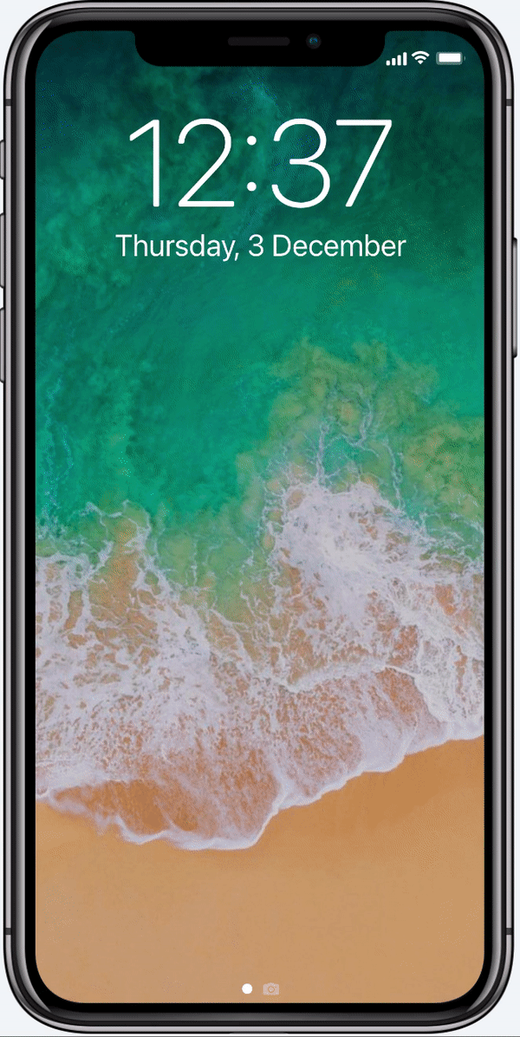
PROTOTYPE
Interactive prototype tested with interviewees
Importing tasks from central
EMR system
Receiving and forwarding a request
Request approval notification- all stakeholders
MEDCO
Notes:
thsi is the MVP that we tested with them
the 3 main value proposition of the solution -
importing tasks to their mobile phones for flexibility
receiving and forwarding requests via app
getting notified of request to all stakeholders automatiocally

Slide 31


INTERVIEW STRATEGY
1ST QUALITATIVE INTERVIEW
QUANTITATIVE INTERVIEW
2ND QUALITATIVE INTERVIEW
WHO
WHO
WHO
3 House Officers
1 IHIS Employee
16 F2F Interviews
14 Calls Interviews
(HOs, Nurses, Medical student)
3 House Officers + Responses from
Landing page
INSIGHTS
INSIGHTS
INSIGHTS
Doctors:
Issue with inefficiencies of protocol
Poor collaboration tools with existing system
Workflow is Siloed with low visibility of tasks
IHIS Management:
Upper management do not understand the problems on the ground
Ideas get executed only if it comes from above
Inefficient way of handling of admin tasks
Low visibility of team’s tasks between healthcare workers
Poor communication of updates regarding patients
Information sharing is critical
Keeping nurses in the loop for patient care helps house officers significantly
Information may be structured differently HO to HO
Adoption of the app may be an issue due to familiarity of current routine / workflow
24/30
22/30
25/30
MEDCO
Notes:
explaining in detail from what we got from our interviews
1- everything on screen
2- 3 main insights are validated
3- on screen

Slide 32
INTERVIEW STRATEGY
Assumptions validated/not validated (to do)
Medical teams that have patients across wards & departments that requires collaboration
System is not designed for collaboration and task management
Poor visibility between different stakeholders
The use of MEDCO will result in a more efficient system which leads to better administrative management
INCONCLUSIVE 50%
VALIDATED 90%
SLIGHTLY VALIDATED 64%
VALIDATED 73%
“Not every department has patients across wards and in some hospitals we are physically together so communicating is not an issue”
- SH, House Officer
“Nurses call us to confirm plans which can be troublesome but is needed.”
- DL, House Officer
“Nurses update each other through whatsapp on the afternoon plans. Not ideal but it works”
- LC, House Officer
“Being a house officer is extremely tiring and overwhelming. I feel that there has to be a better way of managing our tasks, but it’s difficult to change anything as everyone’s so busy”
- BK, House Officer
“Sometimes tasks get forgotten and it leads to delay in patient’s treatment”
-YT, House Officer
MEDCO
Notes:
Overall we had 1 inconclusive point regarding the type of teams that need this collaboration. However, for the rest of the assumptions, through our interviews it was very clear that current system is inefficient, there’s poor visibility, and too much manual communication. Overall there is much to be done to improve the system. )

Slide 33
INTERVIEW STRATEGY
Additional Insights
Writing notes during
rounds is inconvenient
Task /Administrative management is
( bad, inefficient, etc)
Healthcare workers want a better view of patient updates within nurses & doctors (of various seniority)
Doctors want an easier
way to write down, sort/prioritize their tasks
“Some HOs prefer to write things down on paper and pen as it is faster for them than typing on the COW (computer on wheels)”
- SH, House Officer
“Sometimes there is severe lack of manpower in one team and excess in other teams”
- NT, House Officer
“Patients sometimes are not able to get optimal medication due to pharmacy not able to refill a certain drug in time”
-SS, House Officer
“Current methods are super inefficient. We still use very traditional methods to work. I have to log onto the EMR system or call a nurse to check if something is completed”
- DL, House Officer
“Senior doctors use often use junior doctors to communicate with the nurses on their behalf”
- LC, House Officer
“Being a house officer is extremely tiring and overwhelming. I feel that there has to be a better way of managing our tasks, but it’s difficult to change anything as everyone’s so busy”
- BK, House Officer
“Sometimes tasks get forgotten and it leads to delay in patient’s treatment”
-YT, House Officer
MEDCO
Notes:
These are additional insights that we got from the interviews as well mainly covering the details and examples on when doctors lack of automation, collaboration tools & communication tools for doctors. As for the Healthcare system, they lack of internal facing tools to understand the ground.

Slide 34


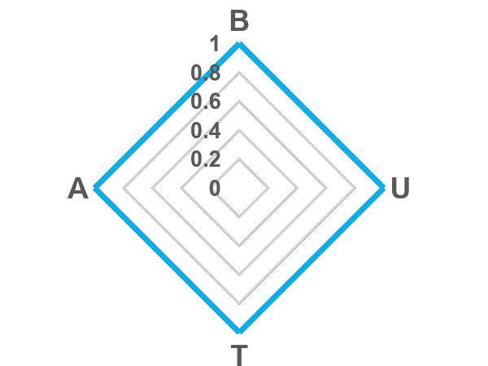
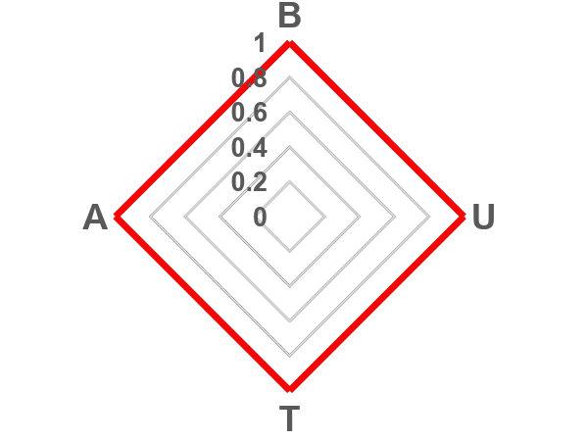
BEACHHEAD SEGMENTS
SURGERY TEAMS WITHIN HOSPITALS
MEDICAL TEAMS THAT HAVE PATIENTS ACROSS DIFFERENT WARDS
Surgery wards require high levels of collaboration amongst doctors
Field of work is highly demanding, little room for redundancy or inefficiency.
Medical teams with patients across different wards face difficulty getting updates and working with colleagues in those different wards.
High need to optimize their workflow to reduce time walking between wards
MEDCO
Notes:
Our 2 beach bead segments are surgery teams in hopspitals and the few medical teams that have patients accross wards that need collaboration tools.
Our app aims to help optimise workflow for these departments that have siloed workflows but yet have a high need for collaboration.

Slide 35
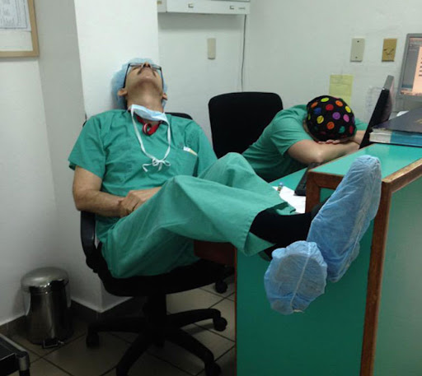

PERSONA
FACTS
PAIN
Works long hours
Feels the loss of passion for his work
Constantly tired
Inconvenient communication within department
Unnecessary calls from nurses
BEHAVIOUR
GOAL
Receptive to technology
Diligent and responsible
Supportive and willing to help colleagues out
Seamless communication within stakeholders
Less time spent on administrative work, more time spent on work that require their doctor expertise
Finish tasks efficiently
Samantha, 25
Overworked house officer
Notes:
our persona will be based on a overworked house officer that seems to be most common among the doctors that we met.

Slide 36

03 LANDING PAGE
Content Iteration
Design Iteration
MEDCO

Slide 37
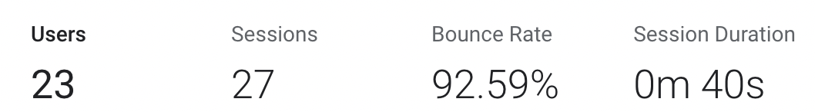
CONTENT ITERATION
FIRST ITERATION STATISTICS
MEDCO
Notes:
After our 1st iteration of our landing page, we wanted to reduce our bounce rate and average session duration.
Hence in our 2nd iteration, we hypothesised that ….
(Increase font size)

Slide 38
CONTENT ITERATION
A/B Testing Objectives
Hypothesis
Making our value proposition more detailed and relevant to each respective stakeholder will lead to positive results
First Round
Test
Test whether content iteration will decrease bounce rate and keep users engaged
Experiment
Clearly split value proposition by stakeholders and provide examples of how MEDCO can be utilised
Bounce rate, session duration
Metrics
MEDCO
Notes:
After our 1st iteration of our landing page, we wanted to reduce our bounce rate and average session duration.
Hence in our 2nd iteration, we hypothesised that ….
(Increase font size)

Slide 39
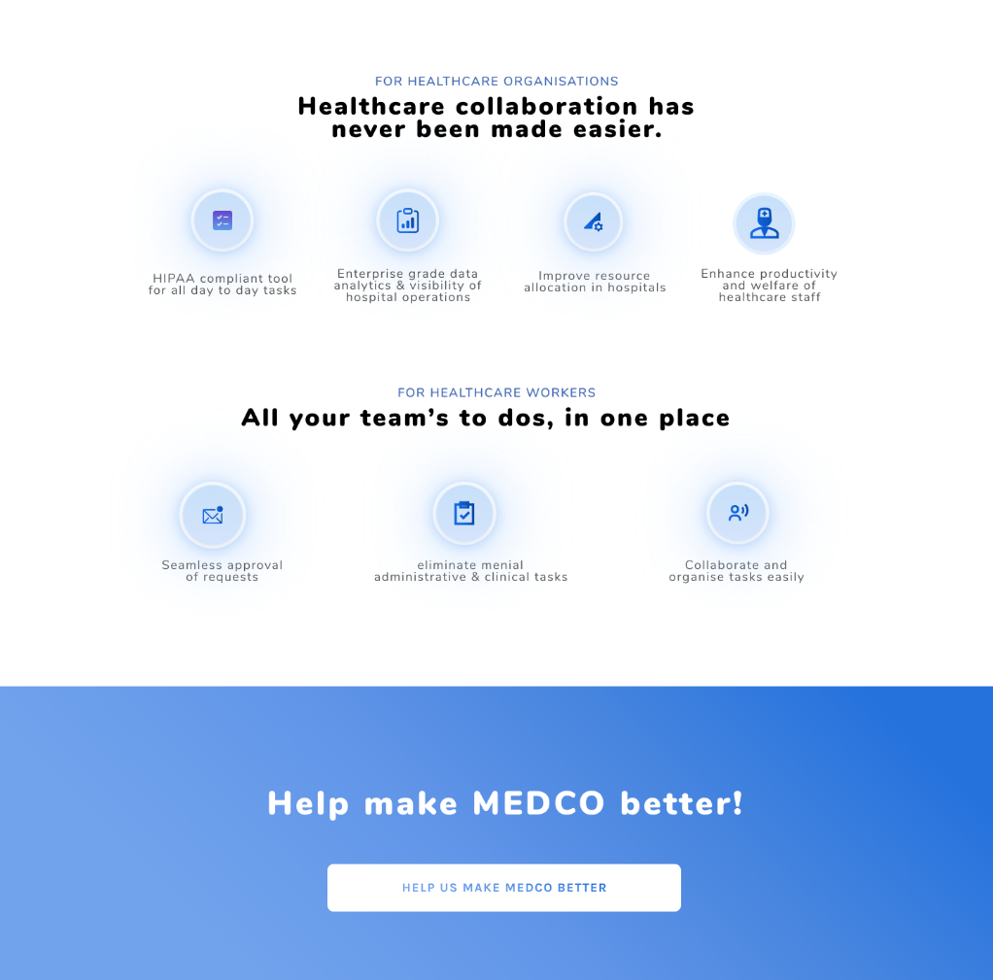
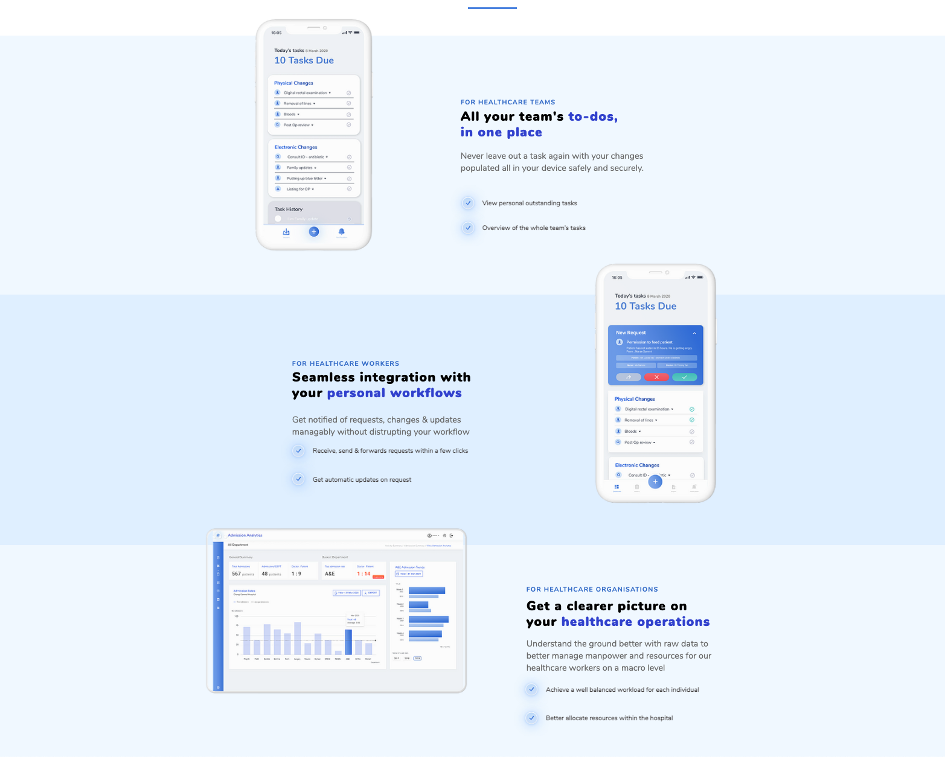
CONTENT ITERATION
A/B Testing
MEDCO
Notes:
By categorising our value proposition by their relevant stakeholders,
it makes it easier for various stakeholders to see only the information that is relevant to them

Slide 40
CONTENT ITERATION
A/B Testing Results
Bounce Rate: -10.33%
Session Duration: + 21s
Insights:
Content iterations resulted in the decrease in bounce rate and increase in session duration
This highlights the importance of content presentation in engaging and retaining people
MEDCO

Slide 41
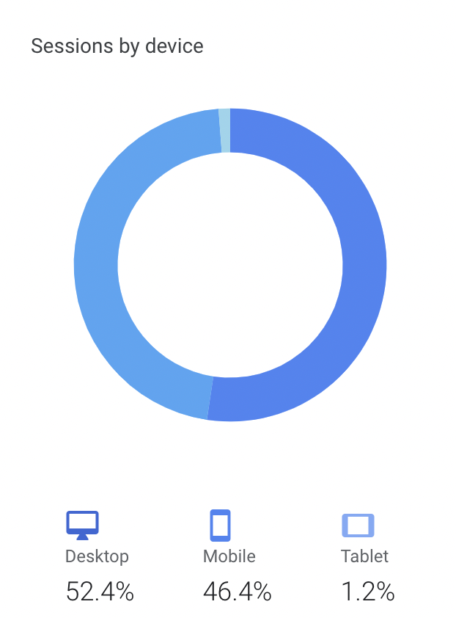
DESIGN ITERATION
Device Session Statistics
MEDCO
Notes:
After our 2nd iteration, we realised that a significant amount of our traffic came from mobile users
although our landing page could be viewed on mobile phones, we hypothesised that ….

Slide 42
DESIGN ITERATION
A/B Testing Objectives
Hypothesis
Making our landing page optimised for mobile users would improve their user experience and lead to positive results
First Round
Test
Test whether design iteration will decrease bounce rate and keep users engaged
Experiment
Change the orientation of our information presentation, reduce length through omission of redundancies and whitespace
Bounce rate, session duration
Metrics
MEDCO
Notes:
After our 2nd iteration, we realised that a significant amount of our traffic came from mobile users
although our landing page could be viewed on mobile phones, we hypothesised that ….

Slide 43
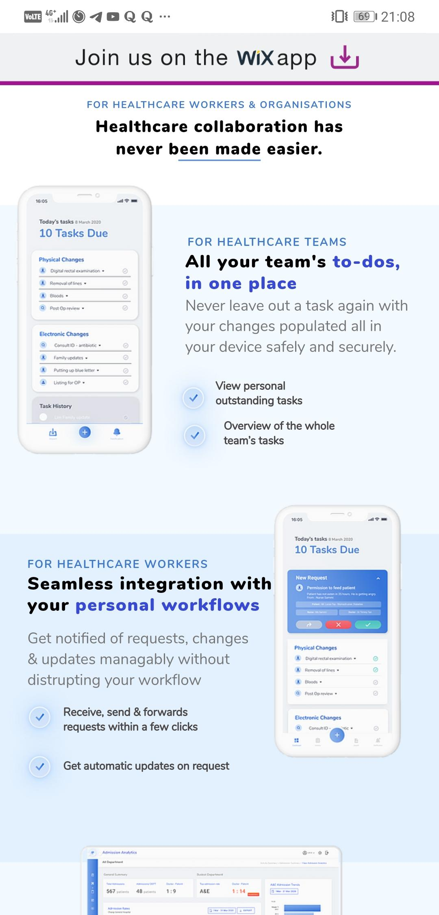
DESIGN ITERATION
A/B Testing
MEDCO
Notes:
Optimising the landing page meant that we reduced the content width and removed a lot of whitespace around our content
This makes the page less lengthy to scroll and converts what was once more suited for a landscape orientation to fit a portrait orientation

Slide 44
DESIGN ITERATION
A/B Testing Results
Bounce Rate: - 4.12%
Session duration: - 5s
Insights:
Design iterations resulted in the decrease in bounce rate and decrease in session duration
This decrease in bounce rate could be indicative of better reception from mobile users
The decrease in session duration could be a result of less time taken to scroll through the content
MEDCO

Slide 45

04 FIELD TESTS
Social Media
Cold Emails
Warm Introductions
Conclusion of Product-Market Fit
MEDCO
Notes:
After our 3rd iteration of landing page was complete, we conducted some field tests to find effective channels to market our product and increase outreach

Slide 46


FIELD TESTING
Field Test Action Plan
SOCIAL MEDIA
WARM INTRODUCTIONS
Decision makers in the healthcare sector on LinkedIn and Clubhouse
IHIS staff, hospital IT, and hospital management
COLD EMAILS
IHIS staff, hospital IT, and hospital management
MEDCO
Notes:
In order to test the various channels we can use to market MEDCO to doctors and hospital decision makers, we conducted 3 field tests for
Social media
Cold emails
Warm introductions

Slide 47
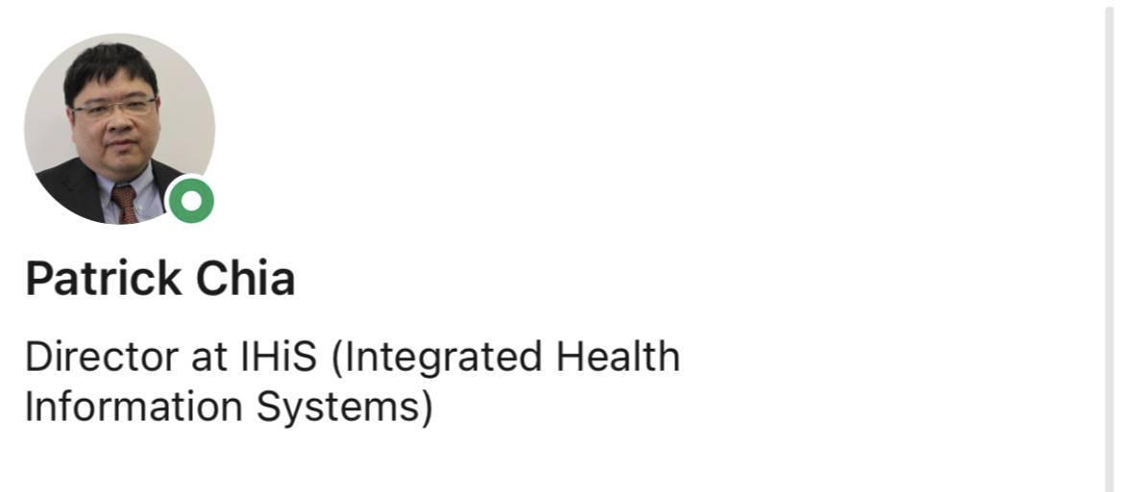
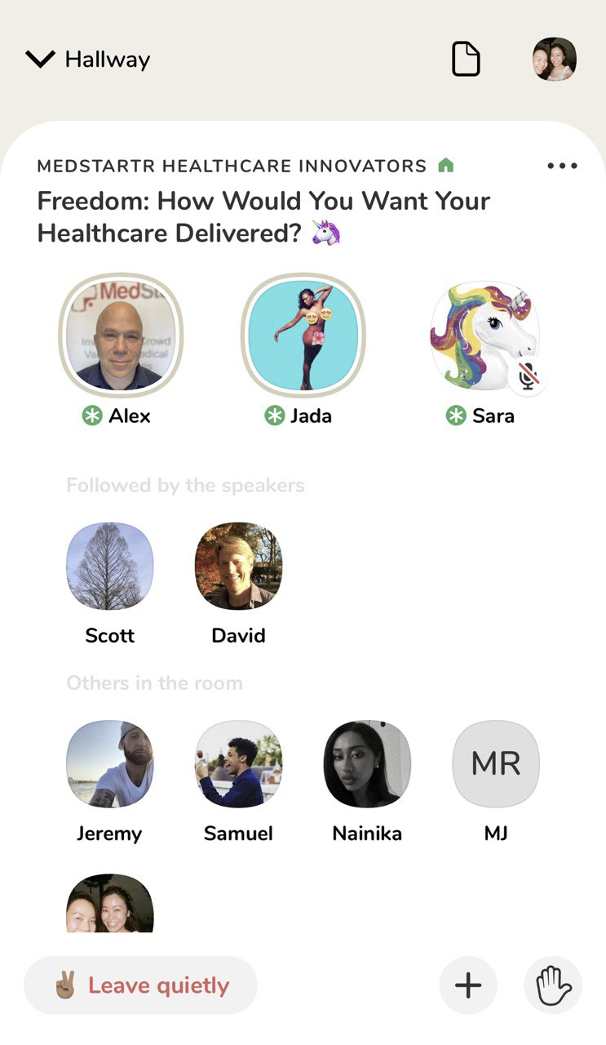
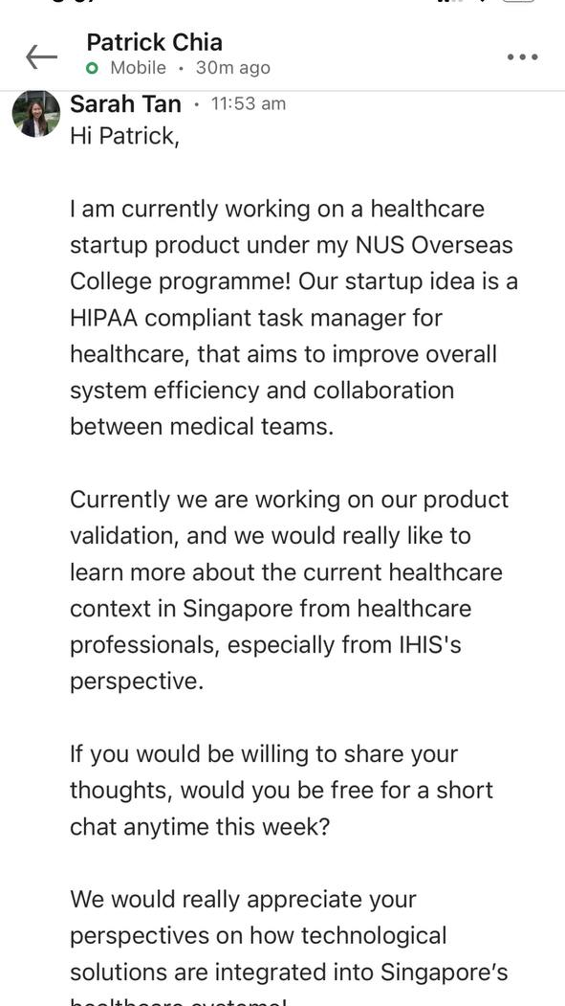
FIELD TESTING
SOCIAL MEDIA
OBJECTIVE
Promote MEDCO on LinkedIn and Clubhouse to decision makers in the healthcare sector
HYPOTHESIS (TO TEST)
Users of such platforms are interested in exploring new opportunities, increasing their willingness to have a visit our landing page and have a call with us
KPI
10 new unique visitors
2 calls from IHIS or hospital management
MEDCO
Notes:
(emphasize objective - highly targeted at decision makers ONLY - alvin)

Slide 48
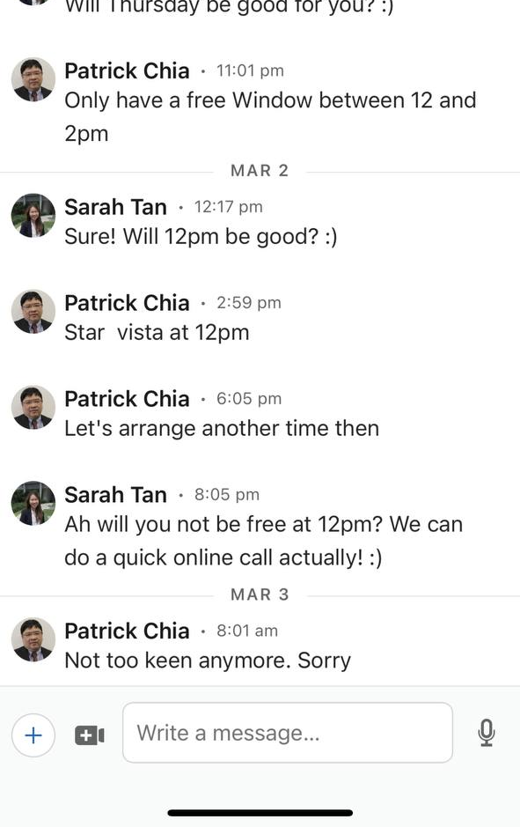
FIELD TESTING
SOCIAL MEDIA
WHAT DID NOT WORK
+ 3 new visitors
0 calls
18 connections
1 response from these connections
Poor perception of social media channels
CONCLUSION
Social media is not the most effective outreach method to corporate level decision makers
We posit that this could be due to social media platforms being viewed as informal channels
MEDCO
Notes:
(anecdote about patrick? - alvin)

Slide 49
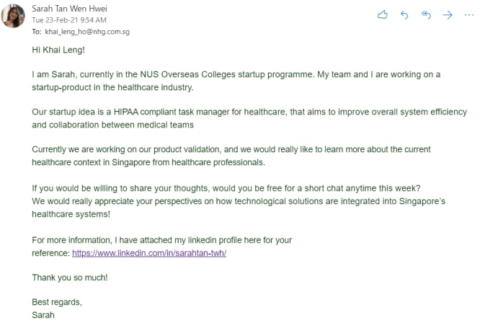
FIELD TESTING
COLD EMAILS
OBJECTIVE
Get access to a connections in IHIS and hospital management beyond our networks
HYPOTHESIS (TO TEST)
IHIS and hospital management staff are interested in increasing productivity and gaining data-driven insights, increasing their willingness to visit our landing page and have a call with us
KPI
10 new unique visitors
2 calls from IHIS or hospital management
MEDCO
Notes:
We decided then to use cold emails, a more formal platform, to gain access to...

Slide 50
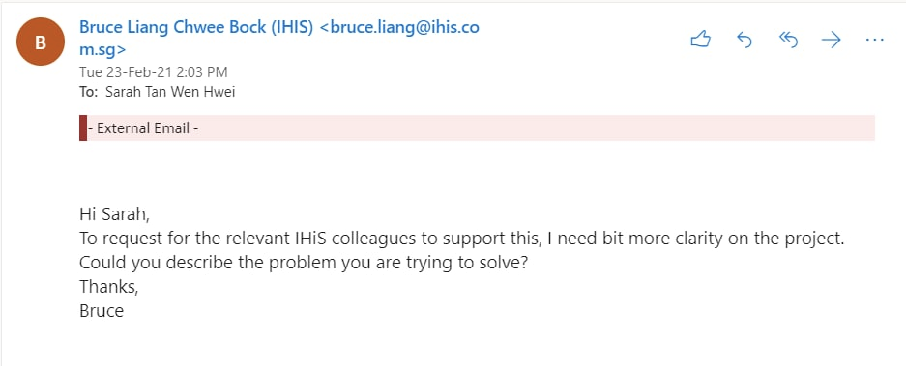
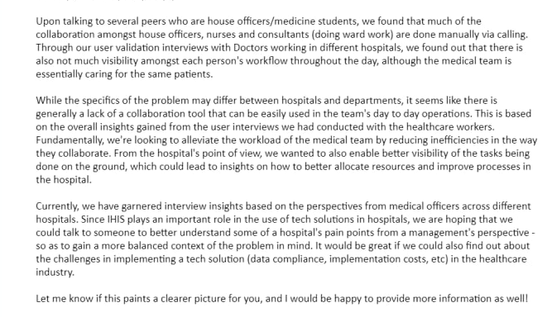
FIELD TESTING
COLD EMAILS
WHAT WORKED/INSIGHTS
Received 1 serious response with further enquiries
WHAT DID NOT WORK
+ 5 new visitors
0 calls
21 emails sent
CONCLUSION
Cold emails are not the most effective outreach method, as it can come across as spam, causing them to disregard our email
MEDCO

Slide 51
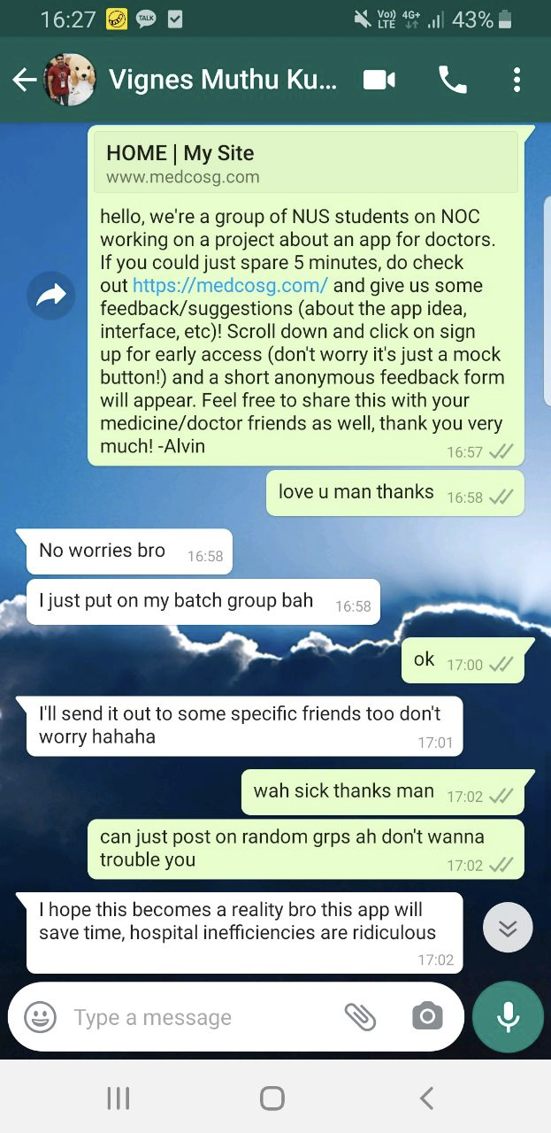
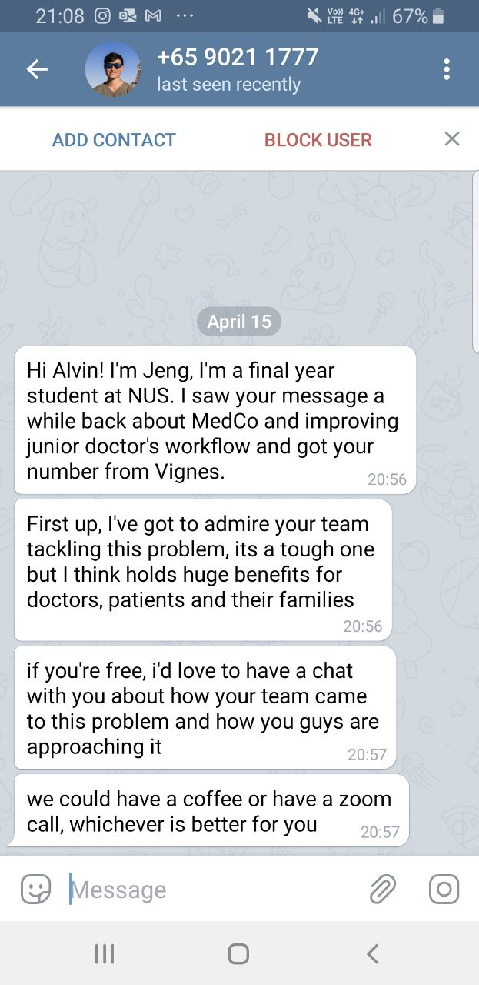
FIELD TESTING
WARM INTRODUCTIONS
OBJECTIVE
Promote MEDCO to doctors and decision makers in the healthcare sector through warm introductions
HYPOTHESIS (TO TEST)
Warm introductions improve users’ receptiveness to learn more about MEDCO, increasing traffic to our landing page, gaining feedback via our surveys, and increasing their willingness to have a call with us
KPI
100 new unique visitors
10 surveys completed
1 call from IHIS or hospital management
MEDCO
Notes:
Thus we arrived at our last field test - warm introductions. Using messaging platforms like telegram and whatsapp, we promoted … (emphasize who we targeting - two distinct groups, doctors and decision makers. message from jeng was inbound! )

Slide 52
FIELD TESTING
WARM INTRODUCTIONS - A/B Testing Objectives
Hypothesis
Video duration affects number of video views
First Round
Test
Test the optimal video length to maximise viewer retention, engagement, and video views
Experiment
A/B Test on our landing page. Video A is 2min 30s long, Video B is 4min 11s long. Video A was on our landing page for the 1st 50 users, while Video B was shown on our page to the next 50 users.
Video Views
Metrics
MEDCO
Notes:
Additionally, we also conducted A/B testing for our landing page. To find the optimal video length, we hypothesised that

Slide 53
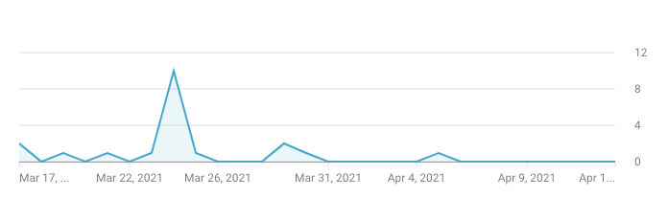
FIELD TESTING
WARM INTRODUCTIONS - A/B Testing Results
INSIGHTS
Shorter video of MEDCO’s use cases gains more views than longer videos
The average view duration across all viewers was 1min 10s
Video A (2min 30s)
28% watched our video
Video B (4min 11s)
8% watched our video
MEDCO

Slide 54
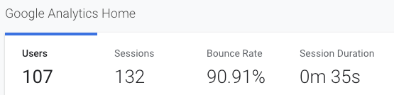
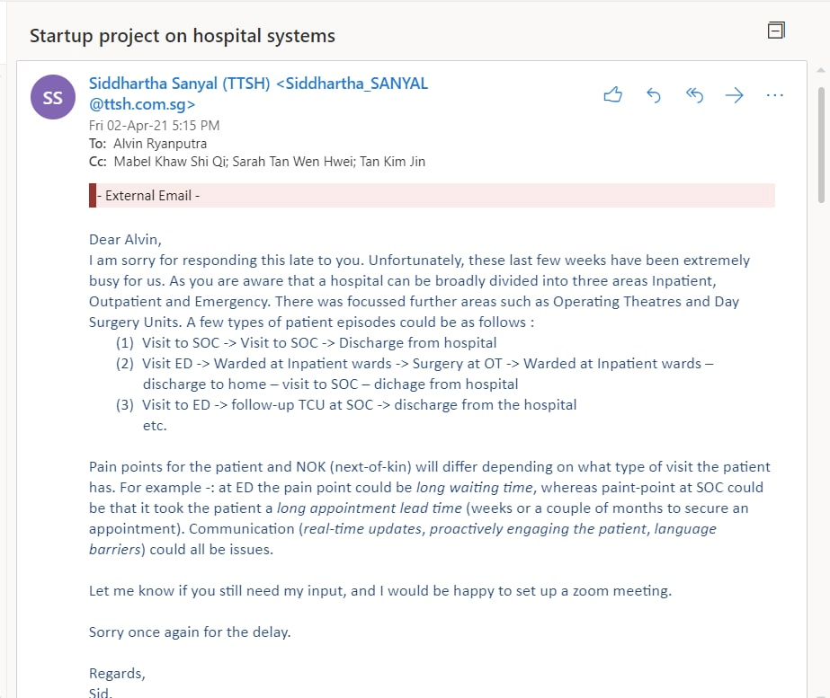
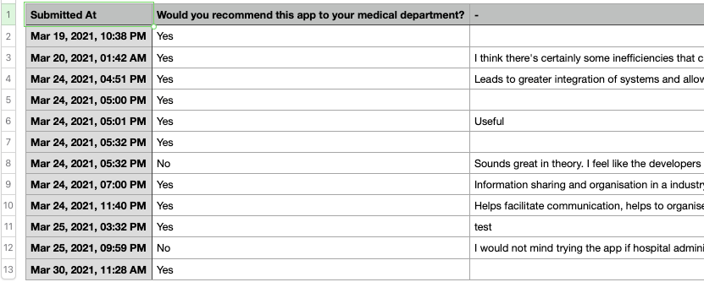
FIELD TESTING
WARM INTRODUCTIONS
WHAT WORKED/INSIGHTS
+ 107 unique visitors
+ 12 surveys completed
Through messaging platforms like Telegram and WhatsApp, with the aid of warm introductions, potential users gained a better understanding of our product
WHAT DID NOT WORK
Still in the process of arranging a call with hospital decision makers
CONCLUSION
Warm introductions is an effective outreach method to potential users
More work needs to be done to make our content more concise and our solution easier to understand
MEDCO

Slide 55
FIELD TESTING
OUTCOME SUMMARY
SOCIAL MEDIA
COLD EMAILS
WARM INTRODUCTIONS
Connections in the healthcare sector on LinkedIn and Clubhouse
IHIS staff, hospital IT, and hospital management
IHIS staff, hospital IT, and hospital management
KPI
10 new unique visitors
2 calls from IHIS or hospital management
10 new unique visitors
2 calls from IHIS or hospital management
100 new unique visitors
10 surveys completed
1 call from IHIS or hospital management
Result
3 new unique visitors
0 calls
5 new unique visitors
0 calls
107 new unique visitors
12 surveys completed
0 calls
MEDCO

Slide 56
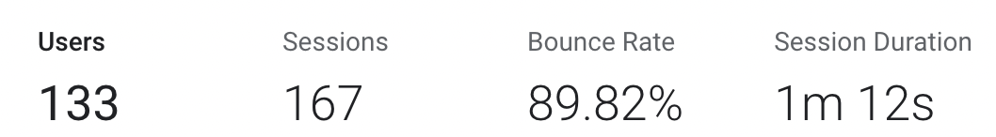
FIELD TESTING
ANALYTICS SUMMARY
USERS
BOUNCE RATE
SESSION DURATION
SURVEYS
KPI
100
60%
2min
10
Result
12
MEDCO

Slide 57
FIELD TESTING
CONCLUSION OF PRODUCT-MARKET FIT FROM FIELD TESTS
PRODUCT
MARKET
Inconclusive
Insight:
Need to ensure that app reduces doctors’ workload
Need to ensure that app guarantees data compliance and security
Validated. Market demand for healthcare workers is present based on our interviews
Not Validated - Market Demand for hospital management
Insight:
Targeting a very niche market
Using doctors’ network and warm introductions will make it easier
MEDCO
Notes:
From our field tests what is the overall conclusion and insights talk about how niche our market is and the direction that we are taking to maximise product market fit
(from interviews) market demand is there (validated the demand from interviews with doctors)
(from interviews) product is inconclusive, can’t say yet
insight
(from interviews) app needs to reduce doctor’s workload (not validated)
niche
(from a/b testing) using doctors’ networks and warm intro is an easier way to reach out to our beachhead segment

Slide 58

05 WHAT’S NEXT
Revised Value Proposition
Latest Product
Market Sizing
Go To Market
Opportunity
MEDCO

Slide 59
THE SOLUTION
Revised Value Proposition
Initial Value Proposition
Revised Value Proposition
HEALTHCARE WORKERS
HEALTHCARE WORKERS
For doctors doing ward work
Who are dissatisfied with the current methods of collaboration within the department,
Our product is a collaboration app for doctors
That enables seamless patient management amongst house officers and senior doctors, unlike existing tools (hospital emr system, tigertext, paper and pencil) which are inconvenient and inefficient.
For healthcare workers doing ward work
Who are dissatisfied with the current methods of collaboration within the department,
Our product is a collaboration app for medical teams
That enables seamless patient management amongst doctors and nurses, unlike existing tools (hospital emr system, tigertext, paper and pencil) which are inconvenient and inefficient.
MEDCO
Notes:
replace medco word with correct design

Slide 60

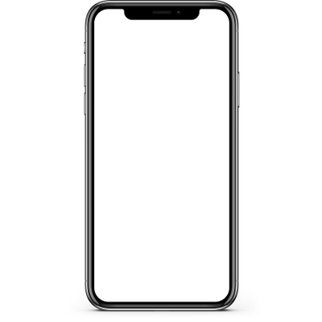
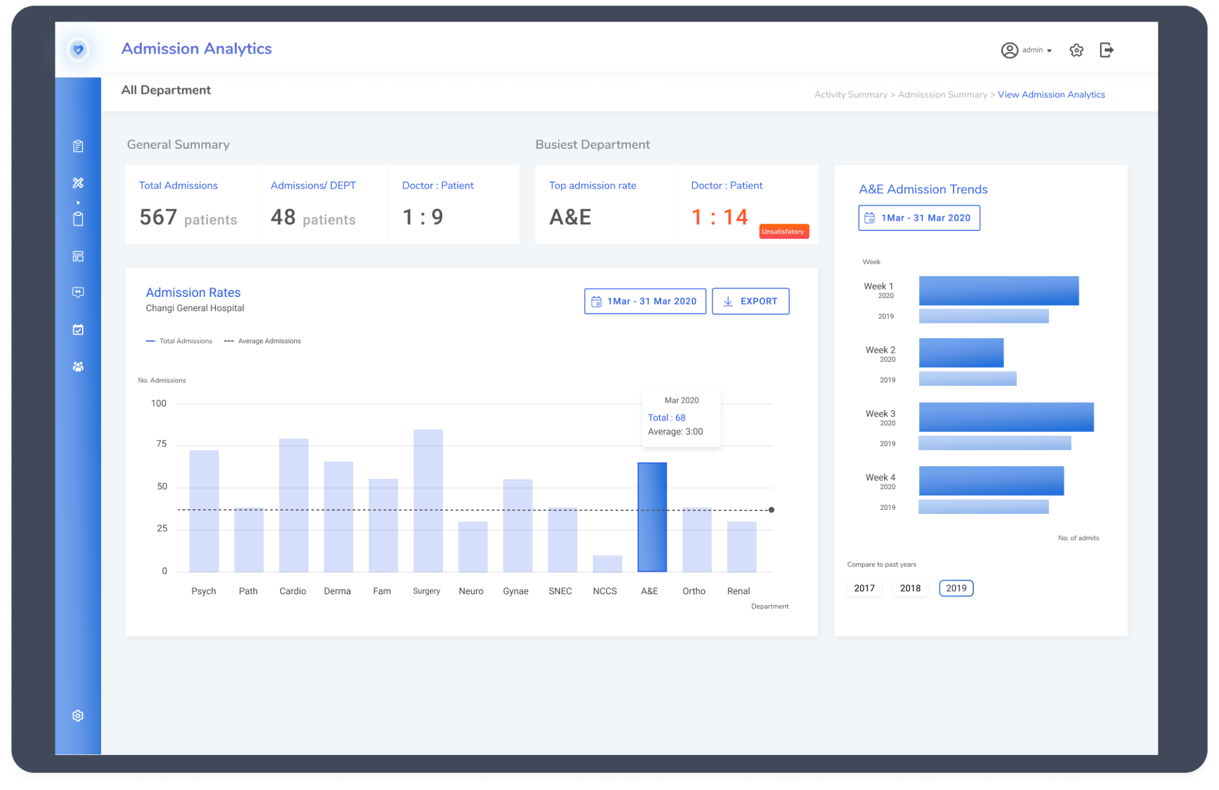
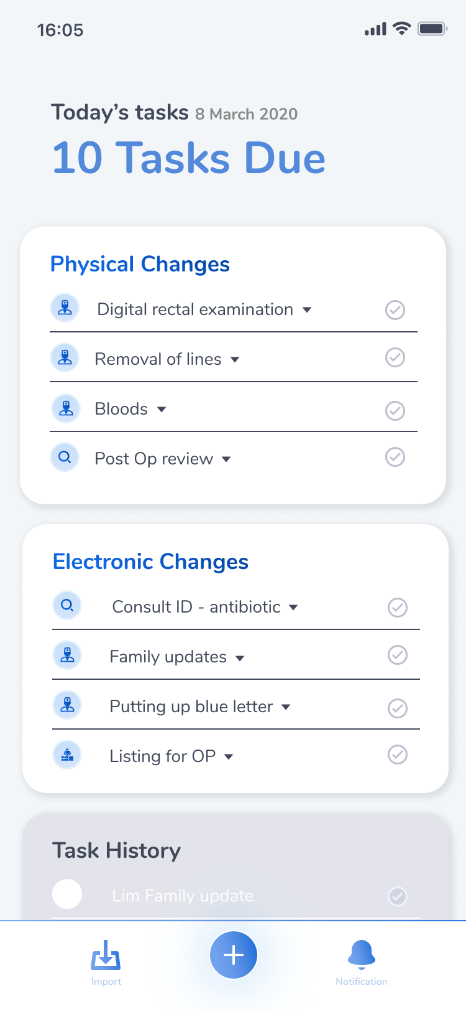
THE SOLUTION
Latest Product
Users
Healthcare workers such as house officers, senior doctors and nurses doing ward work in hospitals, hospital management staff
Purchaser
Healthcare institutions (eg Singhealth) or Individual hospitals
(eg NUH)
Pricing
Priced per head (use of app) + flat amount (use of enterprise software)
Limitations
Integration with existing EMR system
Data privacy compliance
Value Proposition
A collaboration app for medical teams that also generates data-driven insights for the hospital management
MEDCO
Notes:
replace medco word with correct design

Slide 61
BUSINESS MODEL
Market Sizing (Estimate)
SGD $15.4M
Serviceable Obtainable Market
⅔ of SG public hospitals use MEDCO
23.3k healthcare workers * $500 = $11.6m
6 major hospitals * 500k = $3m
3 community hospitals * 250k = $0.75m
Total = $15.4m
SGD $16.4B
Serviceable Available Market
APAC Healthcare IT market. growing at 7% CAGR until 2025
SGD $99.5B
Total Addressable Market
Global Healthcare IT market, growing at 10.7% CAGR until 2028
MEDCO
Notes:
hospitals around the world startnig to - digitize operations, improve patient care, reduce costs

Slide 62


STRATEGY
Go To Market
Top down approach
Approach decision makers / influencers
C level executives
Directors
Head Consultants
Illustrate potential ROI and improvement in hospital care, healthcare worker welfare
Bottom up approach
Market to healthcare workers, create community awareness of MEDCO and create pressure up the hierarchy
MEDCO
Notes:
icon or stock photo?

Slide 63








STRATEGY
Road Map
INTERVIEW WITH IHIS
INTERVIEW WITH HOSPITAL MANAGEMENT
DEVELOP ENTERPRISE SIDE MVP
PITCH TO HOSPITAL DECISION MAKER
Understand how tech solutions are implemented in healthcare institutions,
Understand management pain points, hospital system needs
Basic EMR integration, key features for hospital management
Suggest POC / Trial within a specific department
SECURE FIRST
POC / TRIAL
Conduct POC on a small scale eg. department / across number of wards
USER INTERVIEWS
LANDING PAGE & MOCKUP
FEATURE TESTING & USER INTERVIEWS
GET CONNECTED TO SENIOR PERSONNEL
GAIN TRACTION WITHIN HOSPITAL COMMUNITY
Understand the problem through in depth user interviews
Validate solution idea and evaluate interest from healthcare workers & hospital management staff
Test core features with healthcare workers, get feedback and iterate
Through MVP testing with users, get connected / recommended to healthcare personnel up the hierarchy
Spread information about medco through word of mouth, pressure decision makers from bottom up
MEDCO
Notes:
icon or stock photo?

Slide 64



STRATEGY
Opportunity
Problem solved is significant and frequent
Hospital inefficiencies and pain points are strongly felt by healthcare workers every day
Solution creates value for both the users and the purchasers
High potential for value add for multiple stakeholders, creation of ecosystem
Technology will get stronger with more data
Over time, data collected from users will keep improving models used for enterprise level decision making and resource allocation
Growing healthcare IT market
Growing geriatric population increasing load on healthcare systems, driving adoption of digitization solutions. Rising investments in development of healthcare infrastructure especially in emerging economies in APAC
MEDCO
Notes:
ANIMATIONS

Slide 65

SUBHEADER XXXX
REFLECTIONS
What we were unable to test
Reflections & Insights
Key Takeaways
Future Steps
MEDCO
Notes:
looking back and reflecting on the project

Slide 66



REFLECTION
What we weren’t able to test
Perspective of hospital decision-makers
Pain points and issues faced by hospital management when managing hospital as a system
Business Model
How should the value add be priced? Flat or per head, or both?
How much are hospitals willing to pay?
Technological Implementation
Integration with existing EMR system
Potential use of learning algorithms to recommend actions based on data collected
MVP Features (in progress)
Need to get healthcare workers to try a working MVP so the main features can be iterated upon
MEDCO
Notes:
help this part is difficult

Slide 67


REFLECTION
Future Steps
Follow up with hospital director, continue trying to get an interview with hospital management
Business pitch for $10k
Build working MVP app for testing
MEDCO
Notes:
not just a project for us, taking medco forward

Slide 68

REFLECTION
Reflections & Insights
Be objective in evaluating ideas
Willing to drop a project that our team members were working on previously, once invalidated by interviews
Went through multiple ideas before MEDCO
Word of mouth referral app
Community app for caregivers
Social investing app
Challenge your own assumptions
Audio transcription technology popular in health tech, but unlikely to work for hospital ward environments & local speech patterns
Discovered a real problem within workflow, pivoted to target it instead
Initially thought of only targeting doctors, turns out nurses/admin staff are also key stakeholders in the problem -> Rebranded as MEDCO from DOCTO
MEDCO
Notes:
aside frmo learning about frameworks and the healthcare industry, we learnt many valuable lessons

Slide 69

REFLECTION
Reflections & Insights
Work on an idea you care about
Personal stake in solving the problem for healthcare workers
Interviews were naturally less tiring to conduct
Believe in the power of networks
IHIS staff member through Mabel’s colleague’s sibling
Hospital director through NOC manager’s colleague’s contact
Managed to reach IHIS leadership / Hospital director through linkedin & cold email, but didn’t manage to get an interview
Sat at hospital cafe to interview our contact’s doctor friends
MEDCO
Notes:
unexpected networks
just ask

Slide 70



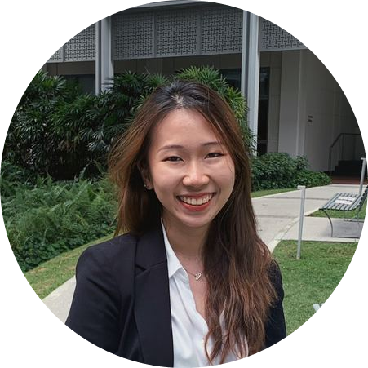
REFLECTION
Key Takeaways
ALVIN
KIM JIN
Questioning the status quo, and attacking assumptions are great ways to innovate
Embrace honest feedback. Don’t listen to reply, listen to understand
MABEL
SARAH
Learning to accept that solutions that we come up with may not always be correct and be willing to iterate (many times)
It is critical to take a step back from your idea, listen to others (and validate!). We must learn what customers really want, not what they say they want or what we think they should want. In the end, it is not about delivering a feature or MVP, but learning how to solve the customer’s problem.
MEDCO
Notes:
NVC may be over, but for us this is just the beginning - regardless where this project takes us, I think this mod was a great opportunity to kickstart our ideas and bring out thentreprenru in each o us

Slide 71

Thank you!
MEDCO

